Slide 1


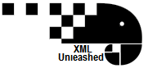
Introduction to XSLT for tei
Part 1: Templates and Default Processing Rules.
A gentle introduction to stylesheets as adapted from the Women Writers Project and Further Adventures in XML
Notes:
This is a gentle introduction adapted from two longer course I have taken in XSLT. It is not meant to be comprehensive. At the end of the two classes you should feel comfortable reading a basic xslt, and performing some simple transforms on your own.

Slide 2
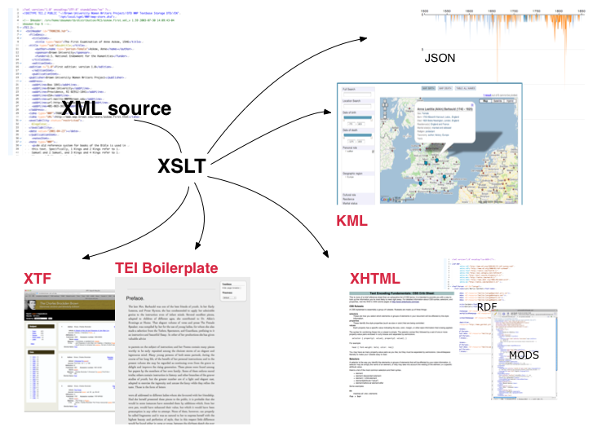
What is XSLT 2.0 : the elevator speech
Notes:
XSLT is a language for transforming the structure of an XML document. In the digital library world, we usually want to restructure our XML for two reasons.
For presentation
For interchange
XSLT 2.0 became a W3C specification in January 2007, and provides several valuable enhancements to the XSLT specifications.
XSLT is a declarative language that lets you define rules describing the desired transformation
The stylesheet is a document that contains these rules; the XSLT processor is a program that applies the stylesheet to the original XML document and performs the transformation
The XSLT stylesheet itself is a valid XML document, and must follow the rules for well-formedness

Slide 3
But first, a review of xml
Namespace declaration
Root element
<?xml version="1.0" encoding="UTF-8"?>
<TEI xmlns="http://www.tei-c.org/ns/1.0" xmlns:xi="http://www.w3.org/2001/XInclude">
<teiHeader>
<fileDesc>
<titleStmt>
<title>MD.Balt.JHU.L.119c</title>
</titleStmt>
<!—publicationStmt start here -->
<publicationStmt>
<authority>Brown University &amp;Tufts University</authority>
<idno type="USEpigraphy" xml:id="MD.Balt.JHU.L.119c">Repeat USEP ID</idno>
</publicationStmt>
[…..]
Comment
Entity Ref
Attribute
Tag
Attribute Value
Notes:
The eXtensible Markup Language (XML) is a markup language that defines a set of rules for encoding documents that is both human and machine-readable. That is, XML is a standard for constructing your tags that describes the structure of a document, rather than just its appearance. It is a simple, flexible and customizable.
A markup language is a system for annotating a document that is syntactically distinguishable from the text.

Slide 4
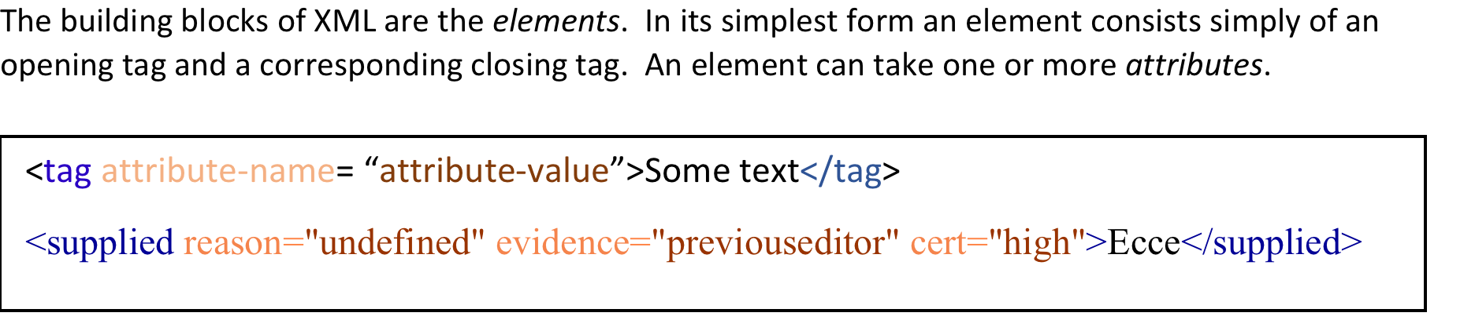
But first, a review of xml
Notes:
Elements and attribute names must follow these rules:
They may contain letters, numbers, ideographs
They may not contain white space, or punctuation other than hyphen, period, and underscore
They must begin with a letter or underscore.

Slide 5
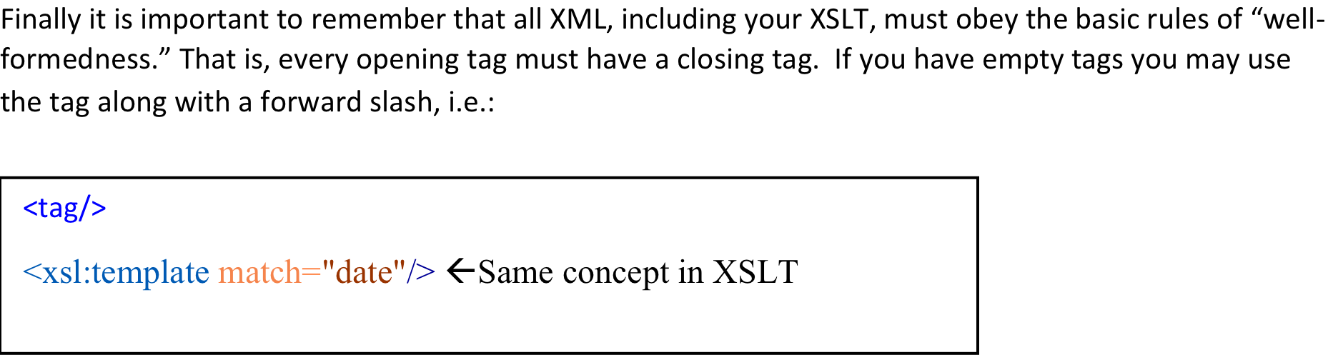
But first, a review of xml
Notes:
Elements and attribute names must follow these rules:
They may contain letters, numbers, ideographs
They may not contain white space, or punctuation other than hyphen, period, and underscore
They must begin with a letter or underscore.

Slide 6
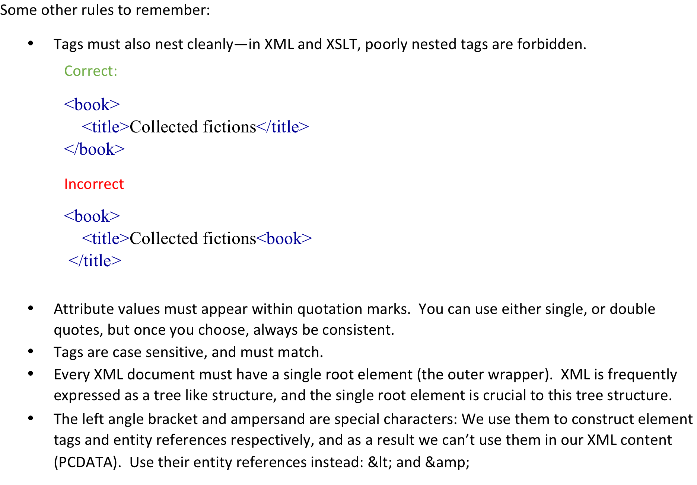
But first, a review of xml

Slide 7
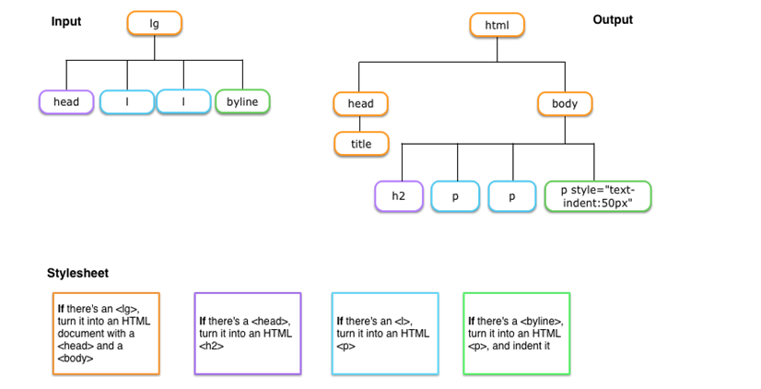
What does an XSLT stylesheet Actually do
Notes:
Basically an xslt stylesheet tells the processor to apply rules piece by piece, transforming the output
The rules are called templates
Each template comes with a set of conditions. N.B.: It sits quietly if it doesn’t match those conditions.
Let’s review what is going on here: The stylesheet looks for a match on the input tree for each condition, when it matches, it applies rules.
In your stylesheets we will write the templates like this:
<xsl:template match="lg"> ←This is the if statement
<html> <head> <title>a poem</title> ←These are the rules that would result in our first output.
</head> <body> <xsl:apply-templates/> </body>
</html>
</xsl:template>

Slide 8
That is….
The processor reads the XML document as a node tree and matches those nodes against the rules in the stylesheet to produce the output document. These rules are called templates, and are structured like this:
Abstract
<xsl:template match=“pattern”>
[. . .]
</xsl:template>
Specific
<xsl:template match="lg"> <html> <head> <title>a poem</title> </head> <body> <xsl:apply-templates/> </body> </html> </xsl:template>
Notes:
Each template has two parts: a pattern (x-path) that identifies the nodes in the XML document that the template can be applied to, and then the instructions about the actual transformation that should take place. When a node in the source tree matches a template’s pattern, the content of that template is created in the result tree.

Slide 9
Structural overview of an XSLT Stylesheet
XML Declaration
<?xml version="1.0" encoding="UTF-8"?>
<xsl:stylesheet version="2.0" xmlns:xsl="http://www.w3.org/1999/XSL/Transform" xpath-default-namespace="http://www.tei-c.org/ns/1.0" xmlns="http://www.w3.org/1999/xhtml"> <xsl:output method="xhtml" indent="yes"/>
<xsl:template match=" emph | foreign ">
<em><xsl:apply-templates/></em>
</xsl:template> </xsl:stylesheet>
XSLT version
TEI namespace declaration
XSL namespace declaration
Top level element
Pattern we will match
xsl element – triggers further processing of nodes
Literal elements
Notes:
The XSLT is itself a valid XML document, and must follow the rules of “well-formedness.”
It contains special elements
The processor reads the XML document as a node tree and matches those nodes against the rules in the stylesheet to produce the out put document.

Slide 10
A Quick word about Namespaces
books.xml
<book>
<title>Collected fictions</title>
<author>Jorge Luis Borges</author>
<publisher>Penguin Books</publisher>
<date>1999</date>
<id>PQ7797.B635 A24 1998</id>
</book>
authors.xml
<author>
<title>Collected fictions</title>
<first_name>Jorge</first_name>
<last_name>Borges</last_name>
<date>1899-1986</date>
<id>79007035</id>
</authors>
Namespaces allow us to disambiguate like things
Notes:
An XML namespace is a collection of element and attribute names names uniquely identified by an explicit or implicit association to a Universal Resource Identifier (usually a url) Namespaces are invoked to differentiate elements and attributes that have the same name but different meanings and different origins. Lets say we have the two documents, and notice how they share two elements: date & id, which are used differently in each context. What if we want to integrate the information? In other words, how would we be able to distinguish between our elements.

Slide 11
A Quick word about Namespaces
<?xml version="1.0" encoding="UTF-8"?> <authors xmlns="http://www.alex.org/authors/" xmlns:book="http://www.may.edu/books"> <first_name>Jorge</first_name> <last_name>Borges</last_name> <date>1899-1986</date> <id>79007035</id> <book:book> <book:title>Collected fictions</book:title> <book:date>1999</book:date> <book:id>PQ7797.B635 A24 1998</book:id> </book:book> </authors>
Here are two namespace declarations. One is the default (the one without the prefix) and the other is explicitly prefixed
Notes:
Although a namespace usually looks like a URL, that doesn't mean that one must be connected to the Internet to actually declare and use namespaces. Rather, the namespace is intended to serve as a virtual "container" for vocabulary and un-displayed content that can be shared in the Internet space. Typing the namespace URL in a browser doesn't mean it would show all the elements and attributes in that namespace; it's just a concept. So why is the URI in the form of a URL? The idea is that URLs are typically used because in webspace URLs are unique. But always remember that they are names, not locations! Namespaces are crucial to xslt because they are what will allow us to distinguish XSLT instructions for the other elements we want to appear in our results document.

Slide 12
A Quick word about Namespaces
<?xml version="1.0" encoding="UTF-8"?> <xsl:stylesheet version="2.0" xmlns:xsl="http://www.w3.org/1999/XSL/Transform" xpath-default-namespace="http://www.alex.org/authors/" xmlns:book="http://www.may.edu/books" xmlns="http://www.w3.org/1999/xhtml"> <xsl:template match="/"> <html> <body> <div> <h1> <xsl:apply-templates select="//last_name"/>, <xsl:apply-templates select="//first_name"/>. </h1> […] </xsl:template>
Here are two namespace declarations again. Note that the default goes into an xpath-default namespace, and the other is explicitly prefixed
Notes:
As already indicated, namespaces allow us to distinguish XSLT instructions for the other elements we want to appear in our results document. Also, your processor will have a fatal error if you do not properly declare your namespaces in your xslt.

Slide 13
A Quick word about Namespaces
<xsl:stylesheet version="2.0" xmlns:xsl="http://www.w3.org/1999/XSL/Transform" xmlns:tei="http://www.tei-c.org/ns/1.0" xmlns:xhtml="http://www.w3.org/1999/xhtml" xmlns="http://www.w3.org/1999/xhtml" xpath-default-namespace="http://www.tei-c.org/ns/1.0">
Notes:
In terms of working in TEI, just copy and past this and you will generally be ok

Slide 14
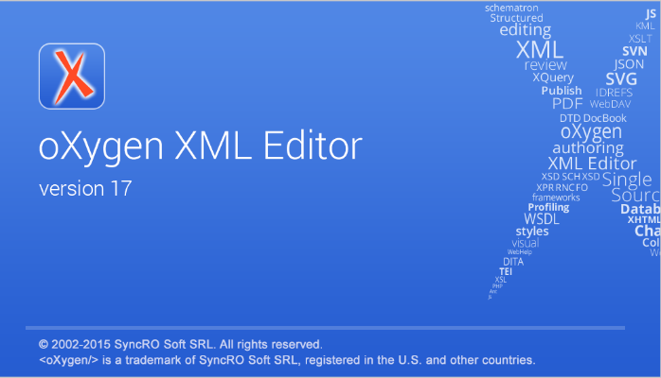
Let’s try it out

Slide 15
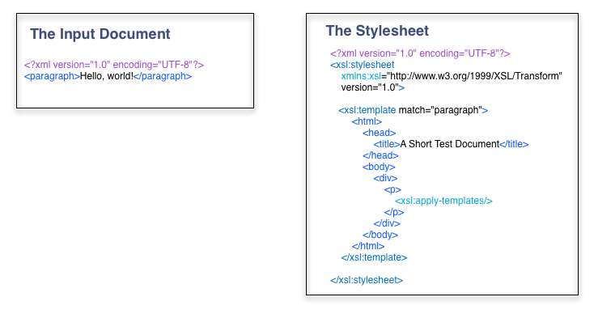
A very simple example
Notes:
Note that we are matching on the element paragraph
If it matches, we are going to produce some literal outputs

Slide 16
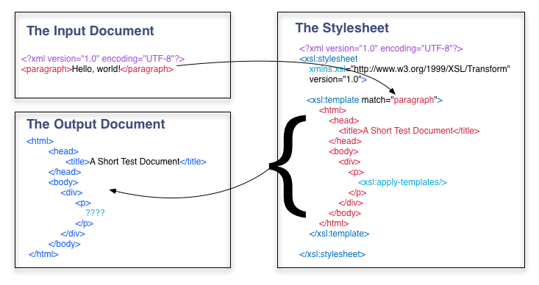
Build our output tree

Slide 17
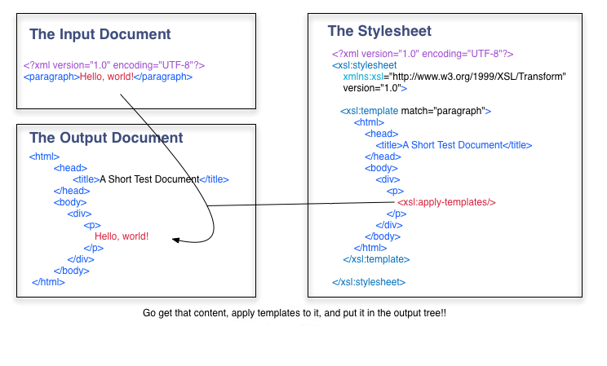
Then fill it with data
Notes:
Xsl apply-template is a green light. It sends us back to the source tree and triggers further processing.
Let’s try playing with this template, add a root element and call it text, then add another paragraph so your xml looks like this:
<text>
<paragraph>Hello world!</paragraph>
<paragraph>This is a silly test.</paragraph>
</text>
If you match on paragraph, and have selected html in your debugger view, your html output will only say: Hello world, but if you look at the text, it should look like this:
<html> <head> <meta http-equiv="Content-Type" content="text/html; charset=UTF-8"> <title>A Short Test Document</title> </head> <body> <div> <p>Hello, world!</p> </div> </body> </html> <html> <head> <title>A Short Test Document</title> </head> <body> <div> <p>This is a silly test.</p> </div> </body> </html>
The processor did exactly what we wanted it to do when we wrote xsl:apply-templates It matched on the first paragraph, produced the literal output, found content and put it into the output tree, it went back, found another paragraph, produced the literal out, found content and put it into the output tree. Its just that what we produced was xhtml, and our browser suppressed the second output.
Lets try one more thing: instead of matching on paragraph, let’s match the root node, which is an abstract point about our root element, and contains everything within it. “/ “matches the root node. See what happens. Note, this is how most xslts start, can you see why?

Slide 18
Let’s try it out

Slide 19
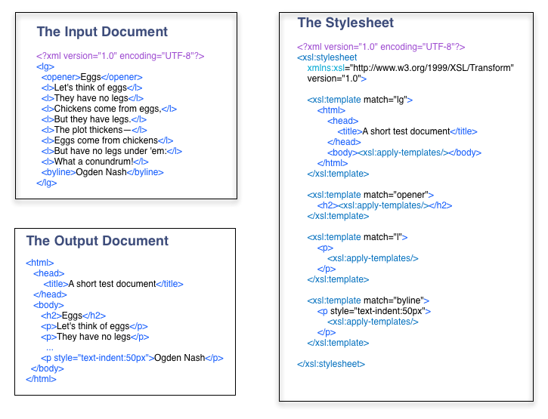
A more detailed example
Notes:
Note: generally order of your templates does not matter, it’s the order of your input tree. Remember the namespace example?
Templates are called so, because they are literally templates for your output document.
Match tells us to match a particular place in our input.

Slide 20
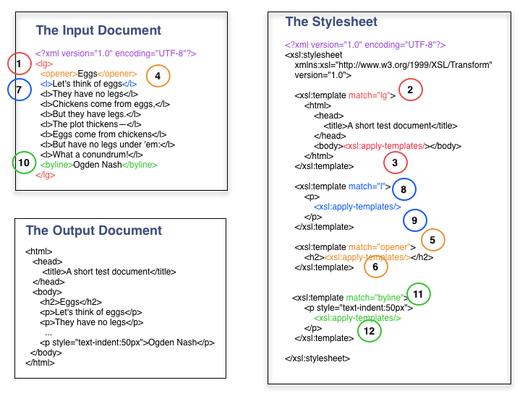
What order did things happen?

Slide 21
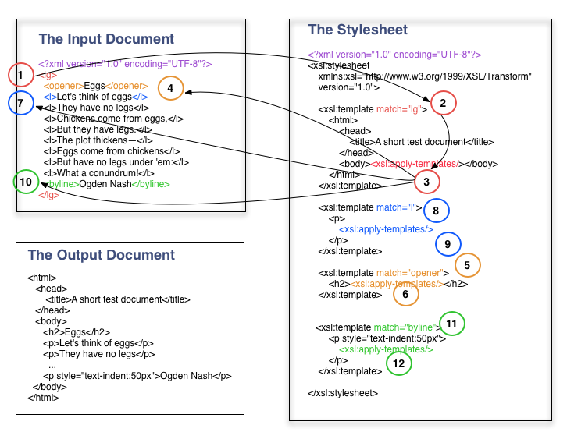
Recursion and dead ends

Slide 22
Recap
Rules in the stylesheet produce the output document
These rules are called templates
Each template has two parts
A pattern that identifies the nodes in the XML document that the template can be applied to
The instructions about the actual transformation
Key takeaway: <xsl:apply-templates/> triggers further processing– it sends us back to the source tree.

Slide 23
Let’s try it out

Slide 24
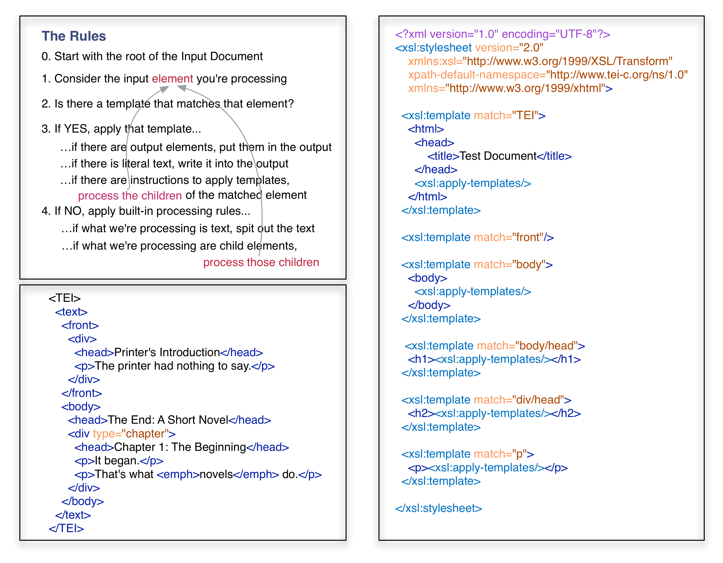
XSLT Processing Model
Notes:
The default rule for the root node and all element nodes is to process all children (ensuring that the whole tree gets processed recursively, from the root, to the outermost branches.
The default rule for attributes specifies that the attribute value is output into the results tree.
The default rule for text nodes specifies that text is output into the results tree.
The default rule for processing instructions and comments is that theses nodes are omitted from the results tree.
Essentially, this means that by default, all elements in the XML input tree, beginning with the root, are processed, and that text content is output into the resulting document, while instructions and comments are left out.
Any template rules you place in your stylesheet, will override these default behaviors. In XSLT, only the best matching rule will be applied to any given node, and more specific rules are better matches than general rules.

Slide 25
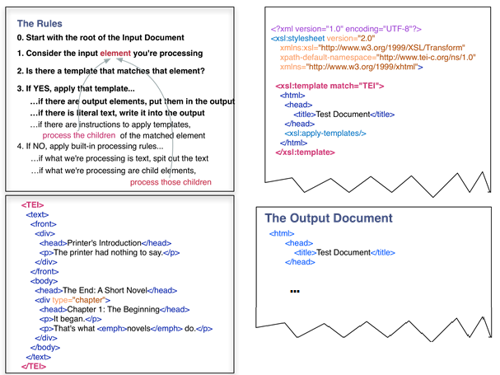
XSLT Processing Model

Slide 26
XSLT Processing Model
Notes:
<xsl:template match=“front”/> this is a rule—it prunes the tree and front and its children will not be output into the tree. This suppresses it because the default rule is to process text and children.

Slide 27
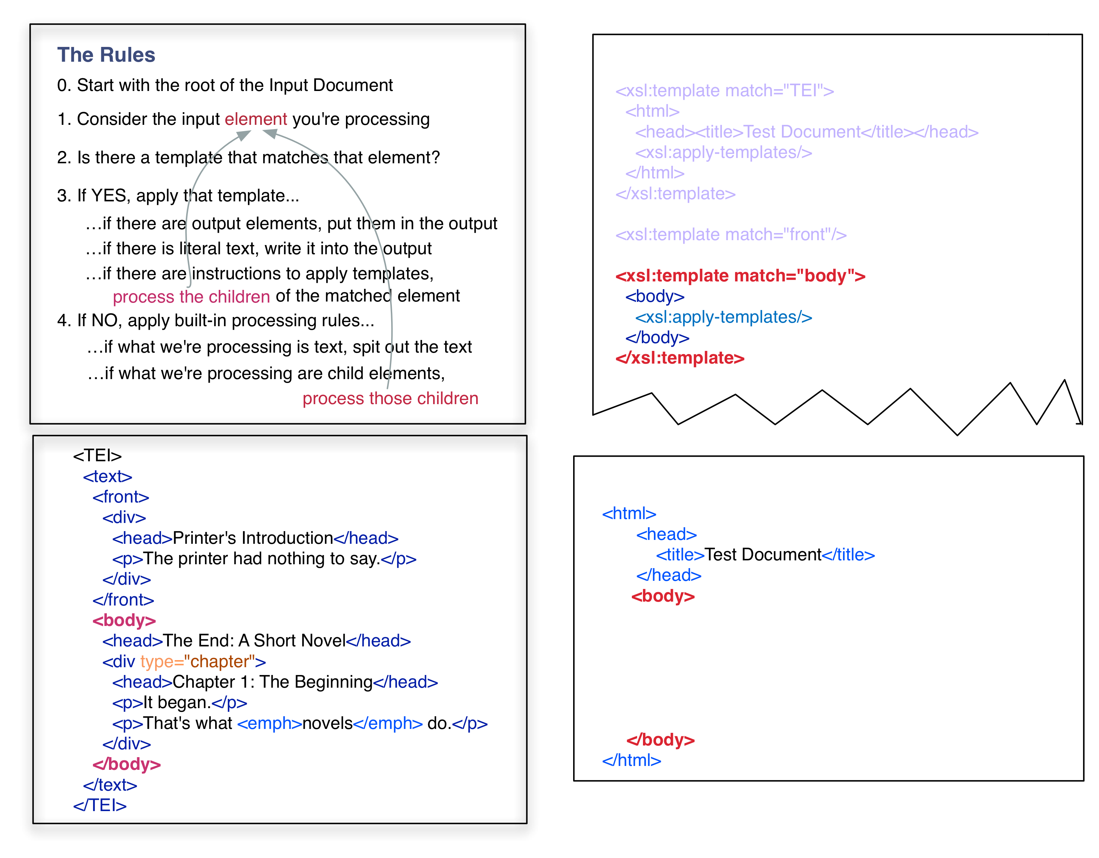
XSLT Processing Model

Slide 28
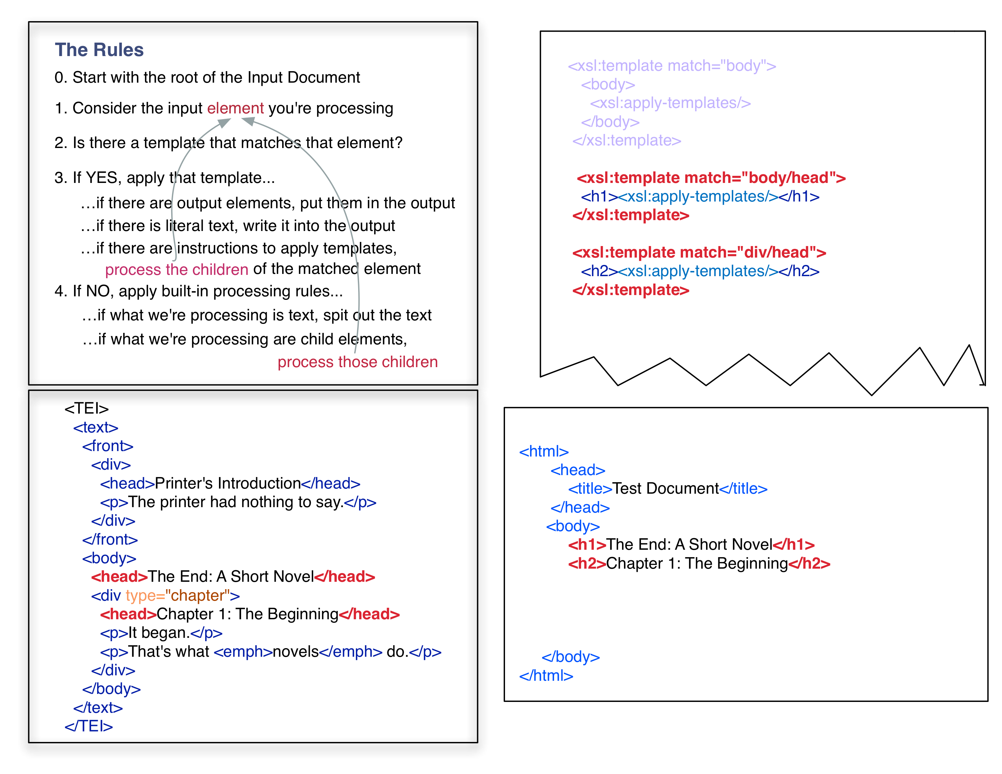
XSLT Processing Model

Slide 29
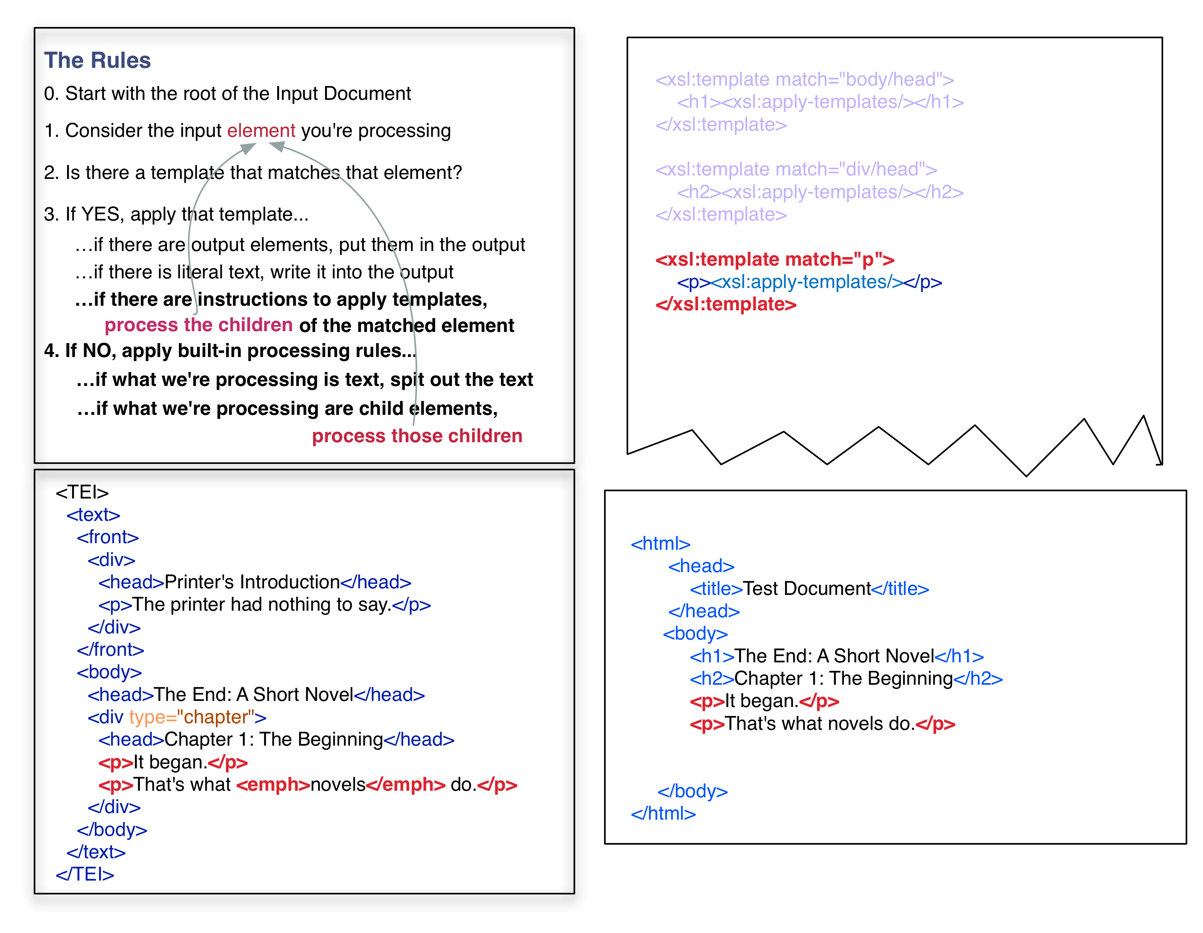
XSLT Processing Model

Slide 30
recap
The default rule for the root node and all element nodes is to process all children (ensuring that the whole tree gets processed recursively, from the root, to the outermost branches.
The default rule for attributes specifies that the attribute value is output into the results tree.
The default rule for text nodes specifies that text is output into the results tree.
The default rule for processing instructions and comments is that theses nodes are omitted from the results tree.
Essentially, this means that by default, all elements in the XML input tree, beginning with the root, are processed, and that text content is output into the resulting document, while instructions and comments are left out.
Any template rules you place in your stylesheet, will override these default behaviors. In XSLT, only the best matching rule will be applied to any given node, and more specific rules are better matches than general rules.

Slide 31
Let’s try it out

